Slide 1
The EUROPEAN UNION
Judicial Powers: EU Fundamental Rights

Slide 2
In This Section…
We will discuss how the judicial powers of the Court of Justice are heavily influenced by fundamental rights.
We will consider:
What are these so-called ‘EU rights’? Where do they derive from?
How are EU fundamental rights used as general principles? Are there any limitations?
How does the EU Charter of Fundamental Rights interact with international/external ‘limits’ such as the UN Law and the ECHR?
What is the UK’s relationship with the EU Charter?

Slide 3

HUMAN RIGHTS AS GENERAL PRINCIPLES
Protection of human rights is a central task of the modern judiciary.
The Fundamental Rights of the European Union constitute one of the most popular grounds of review in actions challenging the validity of EU law.
Three Sources of EU fundamental rights can be found in Article 6 TEU.
We will now examine each source, as well as the national courts’ obligations in relation to European Fundamental rights as well.

Slide 4

THE UNWRITTEN BILL OF RIGHTS
The European Court developed an unwritten bill of rights for the Union that were separate from national constitutions.
Stork [1958] held that national fundamental rights couldn’t be a direct source of European Fundamental Rights.
Implied European Fundamental Rights?(Stauder vs. City of Ulm [1969])
Internationale Handelsgelsellschaft [1979] confirmed the existence and the protection of fundamental rights within the European Legal Order.
Nold [1974] clarified the indirect relationship between national rights and European rights, i.e. that the Union would dram inspiration from common constitutional guarantees of the Member States.
The European Convention on Human Rights became significant in identifying the fundamental rights for the EU. (Hochst [1989])

Slide 5

THE EUROPEAN STANDARD
Human rights represents fundamental rights of society.
(Nold [1974]): The Court “was bound to draw inspiration from constitutional traditions common to Member States.”
Maximum and minimum standards approach have both been rejected by the Court.
European Court of Justice not initially formally bound by the European Convention on Human Rights. (Nold [1974])
Article 6(3) TEU incorporated the ECHR as a direct standard of Fundamental Rights for the Union.
Unions standard for the protection of fundamental rights is an autonomous standard.
Drawing inspiration from Member States and the ECHR leaves the Court freedom to protect what it sees as shared values.

Slide 6


limitations
Schmidberger [2003]: There exists absolute rights under the European constitutional tradition that cannot be limited.
However, most fundamental rights are relative.
Hauer [1979]
  Human rights, according to the Court of Justice, can be subject to national limitations.
  But, these limitations need to be proportionate to the public interest pursued.
Zambrano [2011] confirms the existence of this essential core doctrine: any limitation must never undermine the “very substance” of a fundamental right.

Slide 7

UNITED NATIONS LAW; AN EXTERNAL LIMIT
Are European fundamental rights limited by international obligations stemming from international human rights?
Bosphorus [1996] established that where the Member States decided to fulfil their international obligations under the UN qua European Law, they would have to comply with the constitutional principles on the Union legal order (European Human Rights.)
This was challenged in Kadi [2005] that strongly proposed that International law prevails over all European law and there are structural limits imposed by general international law upon the judicial review powers of the European Court.
On Appeal however the position returned to that of Bosphorus [1996].
All European legislation is limited by the respect for fundamental human rights.

Slide 8

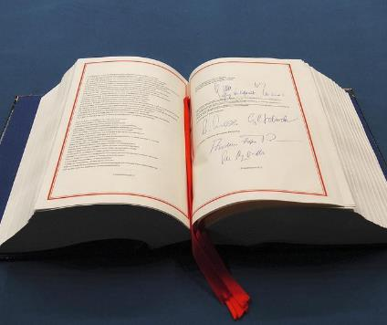
THE CHARTER OF FUNDAMENTAL RIGHTS
Written bill of rights for the EU.
The Charter aims to codify existing fundamental rights using various sources to do so. (The explanations clarify these sources)
Six classes of human rights protected by the Charter: i. dignity , ii. freedoms, iii. equality, iv. solidarity, v. citizens’ rights, and vi. justice.
Classic liberal rights → Title I-III & Title VI
Rights of workers, family and healthcare → Title IV
Citizens rights → Title V
General principles on interpretation and application → Title VII
The charter draws a distinction between hard rights and soft principles:
  Hard rights have direct effect and can be invoked before a court, whereas a soft principle is not a right but an objective guideline that needs to be observed. (Article 51(1) of the Charter)
  Rights are derived from principles.

Slide 9
LIMITS ON THE CHARTER
Article 52 of the Charter establishes general rules for limitations to all Fundamental Rights:
Any limitation of fundamental rights must be provided for by law. (prohibits human rights violations as a result of individual acts based on autonomous executive powers. Knauf Gips [2010])
Material reading on this provision provides that the requirement for each limitation being provided for by law doesn’t require direct democratic legislation but insists on the liberal demand that all interferences are rooted in a generally applicable norm. (Schecke & Eifert [2010])
Proportionality principle & the Essential Core doctrine are also generally applicable.
Provided for by Law
Rooted in a generally applicable norm.
Proportionality Principle
Essential Core Doctrine
Cannot limit the core purpose.

Slide 10

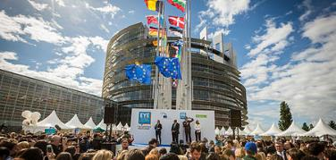

THE CHARTER & EUROPEAN RELATIONS
Charter exists out-with the EU Treaties.
Article 6(1) TEU; Charter has the same legal value as the treaties.
Article 52(2) of the Charter governs the relationship between the Charter and the Treaties. (lex specialis derogate lex generalis)
This Photo by Unknown Author is licensed under CC BY-SA
Article 52(3) of the Charter appears to materially incorporate the ECHR into the Charter.
Ambivalent wording of this provision.
Simple interpretation is that the level of protection afforded by the Charter may never be lower than that guaranteed by the ECHR.
ECHR establishes a minimum standard for Charter rights.
This Photo by Unknown Author is licensed under CC BY-ND

Slide 11
THE EU AND THE ECHR
The EU has still not acceded to the ECHR.
The ECHR has found that a limited indirect review of Union Acts can occur. (M & Co vs. Germany [1990])
Bosphorus [2006] has established that Member States are not responsible for every EU Act that violates the ECHR
The transfer of power to the EU will be subject to a presumption that the State had not violated the ECHR by doing so → this low standard of review is a form of compromise)
Once the EU accedes to the ECHR, Strasbourg will be able to directly review Union Acts.
Accession will widen the scope of application of the ECHR to include direct Union action.
The European Court is halting the accession process to the ECHR via Opinion 2/94 [1996].
Article 6(2) TEU establishes the objective of accession for the Union however Member States are able to still block this from occurring.
Once accession to the ECHR occurs there will still be need for an incorporation doctrine as even though the standards will be the same, the formal legal effects will be different.
Article 216 TFEU will make the ECHR binding upon Member States as well as the Union.

Slide 12
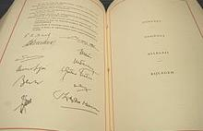
INCORPORATION DOCTRINE
EU fundamental rights in certain circumstances are binding upon the Member States.
The Unions autonomous human rights standards may be higher than a national standard.
European incorporation of the EU standard into national law can occur in two situations: implementation and derogation.
Wachauf [1989] confirms that EU human rights bind national authorities when they implement EU rules & that Member States are bound to respect EU fundamental rights in using its national competence.
Member states act as decentralised executive branches of the Union.
ERT [1991] introduced the derogation situation as when a State relied on European Law in order to justify rules that are likely to obstruct the exercise of a freedom, the justification needs to be interpreted in light of the fundamental rights.

Slide 13

THE INCORPORATION DOCTRINE & THE CHARTER
Article 51 of the Charter makes it clear that the Charter is only binding on Member States when they are implementing EU law. (Codification of Wachauf [1989])
No codification of derogation situation.
Fransson [2013] establishes that the European Court will give a broad reading to the incorporation situation provided for in Article 51 which will allow the inclusion of the derogation situation.
Higher national standards will always be protected via Article 53 of the Charter.
Melloni [2013] rejected that Article 53 challenges the supremacy of EU law.
There is a parallel application of EU and national fundamental rights. (See Promusicae v. Telefonica de Espana [2008])

Slide 14
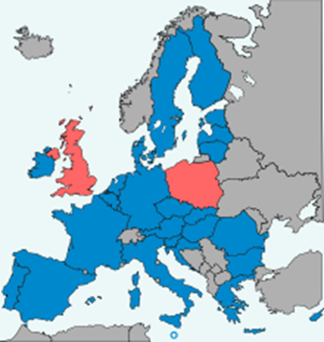

Special rules for Poland & the uk
These special rules exist because of Protocol 30 which is known as a partial opt-out from the Charter.
The provision doesn’t call into question the applicability of the Charter in the UK or Poland.
Article 1(1) of the Protocol states that the Charter must not extend the review powers of national courts to find national laws incompatible with EU Rights.
Article 2 of the Protocol provides that national laws can govern the exercise of a European Right in the UK or Poland

Slide 15

conclusion
Protection of human rights is a central task of the European Judiciary.
Three bill of rights are enshrined in Article 6 TEU.
There are different sources of human rights that are protected within TEU.
Complex relationship between internal bill of rights and external.
Accession of the EU to the ECHR will spell the next era of development of fundamental rights within the European Union.
Questions to consider:
Does there need to be three separate sources?
What about human rights and private actions?
What about the European Social Charter?

