Slide 1
The EUROPEAN UNION
Competition Law: State Interferences

Slide 2

State interference
Modern States can have a big influence on National Markets and can interfere with the structure and competitiveness of them.
Two types of Market interference by States are addressed in the Treaties;
Article 106 refers to public undertakings
Section 2 of the Competition Chapter refers to State Aid.

Slide 3


Public undertakings & public services
Public authorities are charged to provide essential public services and in order to facilitate this, States interfere in their economies where private markets cannot unconditionally produce the public goods required.
Creation of mixed economic systems- private and public undertakings coexist.
Article 106 TFEU governs public undertakings in order to ensure that public undertakings are
not used to violate competition rules.
Article 106(1) &(2) are directly effective despite the Commission via (3) being charged with the enforcement of these provisions. (autonomous regulatory power)
Member States must refrain from any measure which could jeopardise the attainment of the Unions [anti-competition] objectives. (Article 4(3)/Article 106 TFEU)

Slide 4

PUBLIC UNDERTAKINGS & SERVICE
Public undertaking is one that is owned or governed by the State.
Article 106(1) also captures special undertakings that have special rights/exclusive rights granted to them by the State.
France v. Commission [1991] qualified the sovereignty of public undertakings by making it clear that these undertakings can be examined and deemed incompatible with EU law.
Scope/Function of Article 106(1)?
  Hofner & Elser [1991] Article 106 is complementary to Article 102 and that Article 106 is breached whenever “a Member State creates a situation in which the provision of a service is limited when the undertaking to which it grants an exclusive right… [to an undertaking] that is manifestly not in a position to satisfy the demand.”
Restrictive scope of Article 106(1) complemented by broader scope of Article 106(3).

Slide 5

SERVICES OF GENERAL ECONOMIC INTEREST
Importance of public services recognised in Article 14 TEU.
Treaty Protocol dedicated to Services of General Economic Interest that distinguishes between economic services (Article 1) and non-economic. (Article 2)
Article 106(2) provides for an additional justification for undertakings
that provide an SGEI.
An SGEI according to BUPA [2008] is left to Member States to define and will only be questioned by the Commission in the even of manifest error.
The Union can only lay down minimum criteria.
  There has to be an act of the public authority entrusting the operators with an SGEI mission
  The mission needs to be (potentially) universal & compulsory.
  Positive & Specific function (doesn’t need to be exclusive)
Where these minimum criteria are fulfilled, a violation of competition rules could potentially be justified under Article 106(2)

Slide 6


PUBLIC SERVICE OBSTRUCTIONS
Application of Article 106(2) requires proof that the full application of the EU competition rules to SGEI undertakings will cause an obstruction.
Proportionality question raised by this; what constitutes an obstruction for the purpose of Article 106(2)?
Corbeau [1993] shows that the Court has accepted that SGEI need to be able to perform their tasks in “economically acceptable conditions,” and that Article 106(2) can justify restrictions to competition in order to prevent cherry picking of the
profitable parts of the overall business.
The grant of an exclusive or special right will only be justified under Article 106(2) where it is necessary for the fulfilment of an SGEI mission. (Ambulanz Glockner [2001])

Slide 7

State aid
State Aid is financial aid given to private undertakings.
Social costs are attached to the giving of State aid (tax payer costs) and these “bail outs,” can also affect competition if the State aids a particular firm within a market, it can also affect the markets within other Member States.
Article 107 TFEU; Jurisdictional and substantive criteria when State Aid will be incompatible with the internal market.
Article 108 TFEU; Procedural framework for the control of State Aid within the Union.
Article 109 TFEU; Regulatory competence granted to the Council in relation to Article 107 & 108.
General prohibition on State Aid that distorts competition and affect trade within the internal market. (Article 107(1))
Formalistic approach, almost all State aid is deemed to distort the competition within a market. (Phillip Morris Holland [1980]))

Slide 8
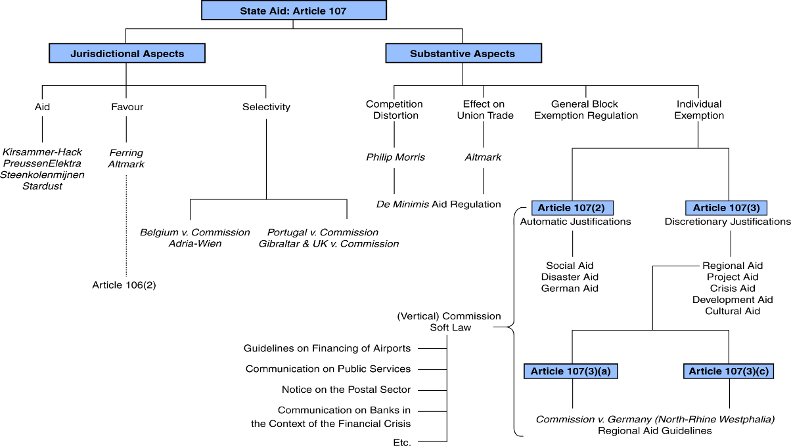

Slide 9

STATE AID & STATE RESOURCES
State Aid requires the direct or indirect implication of State resources. (NVFHW & others [1982])
Kirsammer Hack [1993] confirms the cumulative relationship of State aid via State Resources.
This limits the scope of Article 107(1) to situations where the State specifically acts within the market.
Concept of State Aid is broad as can be seen in Gezamenlijke Steenkolenmijnen [1961]
Broad interpretation as to what State resources constitutes.
Stardust [2002] illustrates that private resources can be considered State resources if the State exercises control over them and the decision to grant the resources is a State decision.

Slide 10
ECONOMIC ADVANTAGE VS ECONOMIC COMPENSATION
Genuine public service obligations
Compensation cannot exceed what is necessary
Compensation reflective of the costs a typical undertaking will incur
Objective & transparent compensation
State needs to act above the market for the use of State resources to constitute State Aid under Article 107(1).
Resources granted needs to give economic advantage to an undertaking. (private creditor test seen in Italy v. Commission [1991])
SGEI & economic advantage?
Ferring [2001] confirms that when SGEI are concerned State Aid is established when the State simply pays compensation to a public service provider.
Strict conditions imposed on the compensation approach as seen in Altmark [2003] which requires the State to act like an ordinary economic actor and 4 criteria to be met.
Commission Regulation on de minimis aid for SGEI (360/2012) establishes exemptions for certain aid.

Slide 11
SELECTIVITY OF THE AID
A national measure needs to be selective within the national territory to be State Aid.
Material dimension of this is that a “special” advantage needs to be granted.
Broad concept of selectivity; Belgium v. Commission [1999] conveys that measures that apply to an entire economic sector can be deemed to be selective for the purpose of Article 107(1).
If a distinction is made between undertakings = selectivity.
Objective discrimination test confirmed in Adria-Wien [2001] used to determine whether distinctions are justified (objective differences allowed) or discriminatory.
Geographical dimension; internal divisions do not matter; regional aid is still deemed to be State Aid.
Portugal v. Commission [2006] Accepted the possibility of a regional framework resulting in measures adopted by a regional government not automatically being selective.
For this to occur the region needs to be institutionally, procedurally and economically autonomous in order for the region to provide the geographical framework for deciding whether a measure was general or selective.

Slide 12


JUSTIFICATIONS (ARTICLE 107(2) & (3)
Legitimate grounds that can render aid compatible with the internal market.
  (2) Legally exempt.
  (3) Exemption is at the discretion of the Commission.
AUTOMATIC JUSTIFICATIONS
Social aid, disaster aid and German aid are all automatically justified under Article 107(2).
Social aid; aid given to individual consumers without discrimination related to the origin of the products concerned. (Abruzzo Earthquaker [2009])
Disaster aid; Court insists on a strict interpretation as to what constitutes a disaster and there needs to be a link between the aid and damage caused. (Atzeni [2006] & Comitato [2011])
German Aid; provision only applies to economic disadvantages caused in certain areas of Germany due to the physical frontier that existed. (Germany v. Commission [2000])

Slide 13
DISCRETIONARY & REGIONAL JUSTIFICATIONS
Softer discretionary grounds under Article 107(3)
Regional, project, crisis & cultural aid.
Regarding the application of Article 107(3) the Commission enjoys a wide discretion, the Court is restricted to determining whether the Commission exceeded the scope of its discretion. (Matra SA v. Commission [1993])
Commission has adopted General Block Exemption Regulation 651/2004 courtesy of the
Council’s permission via
Article 109.
Development of certain economic areas
Areas where standard of living is low
  Article 107(3)(c)
  No criteria in Article to define c-regions.
  Cannot adversely affect trading conditions to an extent contrary to the common interest.
  GBER & the Commission Guidelines on Regional Aid cover the administrative regime for c-regions and a-regions.
  Regional aid map drawn up by the Member States and approved by the Commission.
  Aid intensity thresholds exist.
  Article 107(3)(a)
  Regions economic development is extremely low compared to Union average.
  State aid to rectify this is also in line with Union cohesion policy as well as national cohesion.
  Commission enjoys broad discretion.
  Union interest still applies (Spain v. Commission [1997]
Regional Aid
  Social cohesion can be achieved through regional aid.
  Regional aid for the purpose of social cohesion is allowed (Article 107(3)
  Two types; Germany v Commission [1987] para 19.

Slide 14
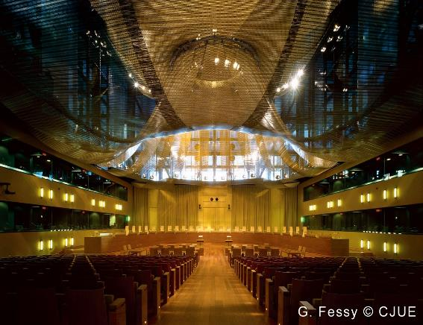
ENFORCING EU COMPETITION LAW
Enforcement can be brought by Member States or against Member States.
Decentralised administration.
State enforcement limited in relation to State aid rules.
Article 103 allows the Council to adopt measures to give effect to Article 101 & 102.
Article 104 designates Member States to be responsible for the application of the competition rules when there is no Council regulation on the matter.
Article 105 places emphasis on the central role of the Commission.

Slide 15
PUBLIC ENFORCEMENT
  Over-centralised approach initially applied via Regulation 17/62.
  This resulted in excessive use and pressure upon the Commission.
  Reform occurred via Regulation 1/2003.
  It eliminated the prior authorisation mechanism for Article 101(3) giving it direct effect.
  National Competition Agencies given a more important role however due to horizontal division of competences between these agencies issues can arise. However despite these issues NCA’s can reject an investigation on the grounds that another Agency is examining it. (Article 13(1)(2))
  Commission is still above NCA’s and decides when to initiate proceedings and hold administrative supremacy. (Tele 2 [2011] confirms this.)
  Commission also has extensive investigative powers (Article 17 & 18)
  Once investigations have been conducted, the Commission hears the case and makes a formal decisions. (Article 27) Three different decisions can be reached as seen in Article 7(1), 9 and 10.
PRIVATE ENFORCEMENT
  Decentralised enforcement through national courts is possible due to ArticleS 101 & 102 being deemed to have direct effect. (BRT v. SABAM [1974])
  National courts are bound by all Union Competition law including Commission decisions.
  Delimitis shows the Union legal order has attempted to coordinate national and Union enforcement of Competition law.
  National courts are to avoid making decisions that conflict with an ongoing investigation by the Commission. (Article 16)
  National courts can however request information from the Commission & the Commission can act as amicus curiae (Commission v. Sytraval [1998])

Slide 16

STATE AID ENFORCEMENT
Union applies a centralised approach to enforcement in relation to State Aid via Article 108 TFEU.
Every Member State is required to inform the Commission of any plans to grant new aid which cannot be implemented without the Commissions authorisation. (Chapter 2 of the Procedural Regulation 659/99)
If this isn’t followed the aid will be deemed to be unlawful but this will not be ipso facto incompatible.
Recovery injunctions can be granted in relation to unlawful aid. (Article 11(2) of Procedural Reg)
The Commission will consider whether the aid is justified under Article 107(2)(3), if it is not the State will be required to alter or abolish the aid. (Decisions made via Article 7 of the Procedural Regulation)
Existing aid needs to be kept under constant review. (Article 108(1))

Slide 17

CONCLUSION
States can interfere with competition within the internal market.
Public undertakings can result in State monopolies and despite being subject to special extensions via Article 106, the State cannot interfere unnecessarily or disproportionately with competition within a market.
Article 107 provides the basis for State Aid which can occur in a broad range of ways.
Both a centralised and a decentralised approach is applied in the enforcement of State interference rules by the Union.
For State Aid, a centralised approach is clearly preferred by the Union.

