Slide 1
The EUROPEAN UNION
Union Institutions

Slide 2
EUROPEAN INSTITUTIONS
Article 13 of the Treaty of Lisbon
The Union's institutions shall be:
— the European Parliament,
— the European Council,
— the Council,
— the European Commission (hereinafter referred to as “the Commission”),
— the Court of Justice of the European Union,
— the European Central Bank,
— the Court of Auditors
2. Each institution shall act within the limits of the powers conferred on it in the Treaties, and in conformity with the procedures, conditions and objectives set out in them. The institutions shall practice mutual sincere cooperation…
Political communities need institutions to govern its society.
Article 13 of the TEU lists the institutions of the European Union according to the Unions legal order & associated bodies.
TEU; Title III
TFEU; Part VI – Title I – Chapter I

Slide 3
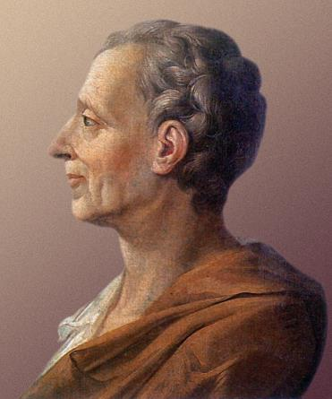
PRINCIPLE OF SEPARATION OF POWERS
According to Montesquieu in 1748 there are three kinds of powers evident in every government:
    Legislative
    Executive
    Judiciary
Judicial power, according to him, had to be separated as the judge cannot be the legislator and should the judge be the executive it could lead to tyrannical rule.
Two models of the Separation-of-Powers principle exist:
    Complete separation of functions
    Cooperation of functions
The European Union adopts the latter model as identified by Montesquieu the exercise of the legislative function should involve more than one institution.
Baron Charles de Montesquieu
“There is as yet no liberty if the power of judging be not separated from legislative power and the executive power.”

Slide 4
THE EU’S SEPARATION OF POWERS
The EU separates the three powers through Article 13(2) of the TEU; The inter-institutional balance principle.
This contains three constitutional demands for the institutions to follow;
Ordinary Legislative Procedure:
There are 3 institutions involved:
Commission must formally propose the legislative bill,
Parliament & the Council must co-decide on its adoption.
Consultation of other institutions important as well as it “represents an essential factor in the institutional balance intended by the Treaties.”
Roquette Freres[1980]
Principle of mutual sincere cooperation; Harmony
Each institution is embedded within the governmental procedures; Balance
Act within defined limit of powers; Cannot extend or transfer powers

Slide 5
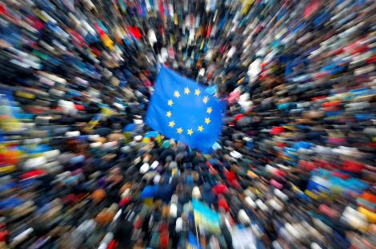
Governmental powers
The European Treaties do not formally classify the Union’s Governmental functions according to a particular procedure. However, there are informal classifications:
Legislative power; competence of making laws.
Executive power; competence of proposing and implementing laws.
Judicial power; competence of arbitrating laws in court.
Fourth power; Involves the creation of “laws,” and execution of war. (Legislative & Executive) Locke,1985
Fifth power; Governmental control of financial markets.
“The principle of institutional balance does not imply that the authors of the Treaties set up a balanced distribution of powers.”
Jacque, 2004

Slide 6
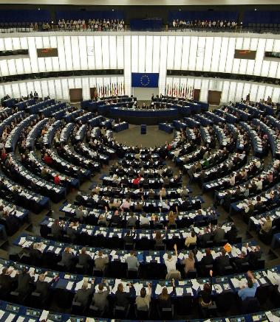
The European parliament
Formation:
Parliament to be composed of representatives of the peoples of the states. (Art 137 EEC)
Elected through proportional representation. (Art 1(1)(3) of 1976 Act)
Composition:
Has a maximum of 751 members.
Seat distribution is degressively proportional between states.
Democratic v. federal principle = quota range 6-96 seats for each state.
Members:
Cannot be members of National Parliaments.
They are not bound by any instructions and can be members of a national political party.
MEP’s serve a 5 year term.
The Parliaments powers were initially auxiliary. It now is one of the main legislating bodies along with the Council.

Slide 7
The European parliament
Internal Structure
Parliament acts as the plenary, however can elect its own President. (Art 14(4) TEU)
President is speaker for the Parliament & represents the Parliament in inter-institutional/international relations. (Rule 22 of Parliament Rules of Procedure)
Bureau; President & 15 Vice-Presidents. In charge with internal organisation, financial and administrative matters of the Parliament.
Conference of Presidents; President & Chairs of Political Parties. Tasked with deciding the parliaments work and legislative planning.
Committees: Decentralised organs of parliament of specialisation. Committees prepare decisions for the Plenary.
Decision-Making & Voting
Plenary sessions happen once a month in Strasbourg in order to vote upon proposed legislation. (Protocol no.6 on the Location of the Seats of the Institutions)
Art 231 TFEU dictates decision making is conducted by a majority of votes case. The quorum is 1/3rd of the component MEP. Double majority is required in some circumstances.
The Parliament Rules & Procedure 171-84 dictates the specifics regarding voting.

Slide 8

Parliamentary powers
Legislative Powers
Can formally/informally propose legislation (Art 225 TFEU)
Ordinary Legislative Procedure: Joint adoption by the Parliament & the Council on a proposal from the Commission.
Special Legislative Procedure: Can result in the Parliament the dominant legislative chamber.
Introduces the consent procedure(Parliament must give its consent before Council can adopt EU legislation.) and the consultation procedure. (Art 22(1), Art 223(2) TFEU)
Budgetary Powers
European Parliament’s budgetary powers focussed on expenditure.
Equal partner in establishing the Unions annual budget. (Art 314, TFEU)
Article 14, Treaty on the European Union
Elective Powers
Executive is elected by the European Parliament. (Art 17 TEU; appointment of the Commission)
Commission is fully appointed and is responsible to the Parliament.
Also involved in the appointment of the Court of Auditors, the European Central Bank and some European Agencies.
Supervisory Powers
The Parliament holds the Executive to account; has the power to debate, question and investigate the union bodies
European citizens have the general right to “petition,” the Parliament and a European Ombudsman conducts inquiries on behalf of citizens into maladministration by the Union Institutions.

Slide 9
THE EUROPEAN COUNCIL
COMPOSITION
Members are the Heads of State’s of Member Countries.
PRESIDENT
Permanent President established elected by the European Council and runs for a term of 2 and a half years.
FUNCTIONS & POWERS
Mainly Executive function (Art 15 TEU)
Institutional Function; influences the composition of Parliament and the Commission (Art 14(2) TEU, Art 17(5) TEU)
Art 15(6) TEU: President is tasked with chairing the Council, ensures the cooperation of the institution with others and presents to the Parliament after each meeting.
Represents the EU externally in relation to Common Foreign and Security Policy.
Constitutional function; For example the Council agrees the eligibility criteria for potential new states and the exit of member states. (Art 49 TEU and Art 50(2) TEU)
Decisions are secret and governed by Art 15(4) TEU.
President cannot be a Head of State and has no voting rights along with the President of the Commission.
The European Council meets twice every 6 months generally in Brussels. (Art 15(3) TEU)
Arbitration powers; Can function like an appeal court in very specifc situations regarding Security and Justice in relation to Criminal Justice Systems. (See Art 82(3) TFEU)

Slide 10

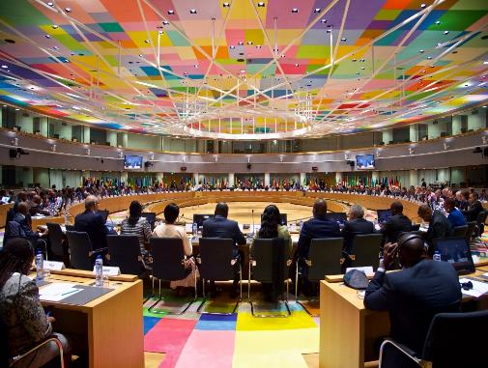
THE COUNCIL OF MINISTERS
Composition & Configuration
Consists of a minster representing each member state’s interests. For each Council configuration the relevant national minister will represent the states in meetings. (Art 16 TEU) There are ten different configurations of Council based on subject matter.
Presidency of the Council The Council Presidency operates under Art 16(9) TEU. This established “team presidencies,” that rotates who is chair every 6 months. Foreign Affairs Council (exception)- High Representative. (Art 18 TEU) The Presidency represents the Council and chairs and prepares meetings.
COREPER
The Council committees; COREPER and representatives in the committees are permanent.
-COREPER II; meeting of the representatives,
-COREPER I; meeting of deputies.
They operate on instructions from Ministers and A items (agreed upon) will be authorised by the Council, B items (no agreement)will be discussed by the Ministers.
The Council is the federal chamber of the EU. (where national ministers meet)

Slide 11


Council of ministers: decision making
technical
political
Working Group Stage:
Attended by attaches from Permanent representatives and Member State experts.
Discussions take place in parallel to Parliament and the Working Groups are advised/intervened upon by the Commission.
COREPER Stage:
Negotiates preliminary deals to Council meetings.
Trade-offs possible.
COREPER II: Member state ambassadors.
COREPER I: Deputy ambassadors to II.
Council of Ministers Stage:
Consists of relevant ministers of all member states for each configuration.
Votes weighed in favour of population (smaller countries weighed more favourably)
Mainly Qualified Majority voting. Unanimity for ‘sensitive’ issues.
power to influence increases

Slide 12

COUNCIL OF MINISTERS: DECISION MAKING
The meetings by the Council are separated into two parts, legislative activities and non-legislative activities.
Voting conducted by Qualified Majority for majority of matters, Unanimity is required for sensitive political matters such as foreign affairs. (Art 16(3) TEU, see Art 150 TFEU for Simple majority procedure)
Member States: Votes
Germany, France, UK, Italy 29 each
Spain, Poland 27 each
Romania 14
Netherlands 13
Belgium, Czech Republic, Greece, Hungary, Portugal 12 each
Austria, Bulgaria, Sweden 10 each
Croatia, Denmark, Ireland, Lithania, Slovakia, Finland 7 each
Cyprus, Estonia, Latvia, Luxembourg, Slovenia 4 each
Malta 3
Qualified Majority: 260/352
Ioannina Compromise; Council is under an obligation when a fourth of the States representing a fifth of the Union opposes a decision; deliberations are to continue.
The Luxembourg Compromise allows a state due to reasons of national interest to impose a no vote in the Council of Ministers and the matter to be referred to the European Council for an unanimous vote.

Slide 13
COUNCIL OF MINISTERS; POWERS
“The Council shall jointly with the European Parliament, exercise legislative and budgetary functions. It shall not carry out policy-making and coordinating functions as laid down in the treaties.” Article 16(1) TEU
The Union can delegate implementation powers to the Council in justified specific areas. This possibility raises a separation of powers issue.
Functions
Legislative
Budgetary
Policy-making
Coordinates
Int’ Agreements
Executive
Co-legislator and still required to legislate
in Public. (Art 16(8) TEU)
Council and Parliament share in the
exercise of the budgetary function.
Dominant institution when it comes to the conclusion of international agreements.
The Council Presidency sets its agenda regarding the specific policy choices that is still within its scope. For example Art 241 TFEU
Member states are required to coordinate their economic policies with the Council. (Open method of coordination)

Slide 14

THE COMMISSION
Acts as the Government of the EU.
The Commission consists of one national of each Member State.
The Commission’s term of office is 5 years. Art 17(3) TEU
The Commission is completely independent. Art 17(3)TEU
The European Council nominates the President of the Commission, then the nominated candidate is elected by the Parliament. The Council then adopts a list of proposed Commissioners from suggestions by member states.
The Commissions democratic legitimacy derives from the Member States and the European Parliament.
The President & ‘His’ College
Chief Commissioner powers (Article 17(6) TEU.
Powers include deciding the Political direction of the Commission, decides upon the internal organisation of the the Commission and can also appoint vice-presidents etc.
The president also represents the Commission. (Current President Juncker)
The Juncker Commission has allocated a nominal portfolio to each Commissioner and they each have their own cabinet.
Project Teams are developed to combine various portfolios under a Vice-President to create more cohesion.

Slide 15

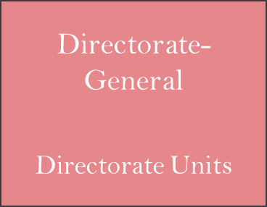
THE COMMISSION’S STRUCTURE
President
Commissioner
Executive Agency
Directorate- General
Directorate Units
Independent Agency
General & Internal Services

Slide 16
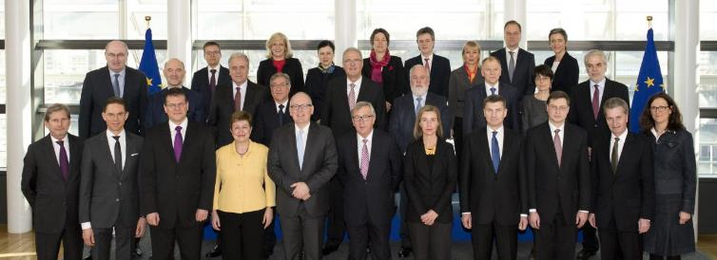
THE COMMISSION: DECISION-MAKING & POWERS
The Commission shall act by a majority of its Members. (Art 250 TFEU)
Four different decision-making procedures (Art 4 Commission Rules of Procedure);
Oral Procedure
Written Procedure
Empowerment Procedure
Delegation Procedure
Each of these Procedures have different rules regarding physical meetings, collective decisions, the separation of A/B items and delegation.
Powers
Article 17 TEU establishes the
Commissions 6 different functions;
Integrative function
Implementation
Monitoring
Budgetary execution
Co-Ordination
External relations

Slide 17



EUROPEAN AGENCIES & THE COMMISSION
The Commission administration constitutes a small bureaucracy.
Creation of Agencies to ensure all of the tasks of the Commission are completed.
Agencies are still not considered an institution of the EU (Art 9, 15 TEU and Art 263 TFEU mention agencies.)
Agencies are created through secondary law and the Commission is limited to what powers it can delegate to an agency.
An Agency's function is to mainly assist the Commission in overseeing the application of EU law whether that be through preparing draft legislation, apply EU law directly or to monitor the application of EU law in a certain area and report back.
Structurally there are two types of Agency; Executive which are under the control of the Commission and Independent which are not.

Slide 18
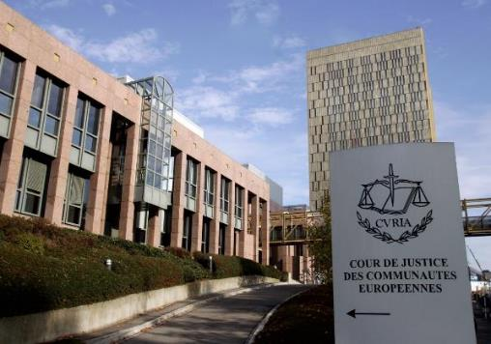
THE COURT OF JUSTICE OF THE EU
The Court of Justice constitutes the Judicial Branch of the EU.
It is composed of various courts for example; The General Court and the Court of Justice. (Art 19(1) TEU)
The Courts task is to ensure that the interpretation and the application of the Treaties law.
National courts are essentially decentralised EU courts however institutionally there is no bridge between these Courts.
The Single European Act established the General Court which now deals with appeals against decisions made in the Specialised Court; The Civil Service Tribunal.
The Court of Justice has a three tiered Court system.

Slide 19
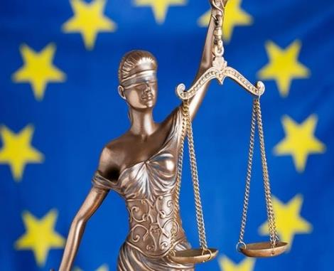
The COURTs OF THE EU: structure
The Court of Justice
Consists of one judge from each member state (Art 19(2) TEU, Art 253 TFEU)
They are appointed independently from the state and do not represent their states interests. (Art 255 TFEU)
Each judge is appointed for 6 years and this can be renewed. (Art 253(4) TFEU)
The Court normally sits with 3-5 judges and the Grand Chamber consists of 15 judges.
In some constitutional cases the Court will sit as a full court. (Art 16 Court Statute)
The General Court
One judge from each member state. (Art 19(2) TEU)
The General Court generally sits with 3 to 5 judges.
Art 256 TFEU; Cases heard.
Decisions can be appealed and reviewed by the
Court of Justice.

Slide 20
THE EUROPEAN CENTRAL BANK
The ECB is independent (Article 282(3) TFEU), has its own legal personality and sits within the European System of Central Banks that is composed of the ECB, National Central Banks of the Member States.
It is an institution of the European Union. (Article 13(1) TFEU)
The ECB is a formal institution of the Union that incorporates NCB’s as decentralised agents of the ECB.
-The Executive Board; which is the monetary executive of Europe established via the European Council
-The Governing Council is the central policy-making organ.
-The Executive Board implements the work of the Governing Council and the Supervisory Board discharges its purpose in liaison with the General Council.
-The ECB President represents the ECB, chairs the meetings of the Governing Council and the Executive Board and takes part in European Council meetings.
-The ECB’s primary objective is to maintain price stability. (Article 127(1) TFEU)
-Article 127(2) and 128(1) determines the basic tasks of the organisation.
-The European Council is the central player in external monetary relations as per Article 219 TFEU.
-It also has an advisory role as well as per Article 282(5).
-The Governing Board; Europes money regulator. Involves the executive board and the governors of the NCB who do not represent their States.
-The Supervisory Board; Supervises large banks to ensure the stability of the financial system within the Union.

Slide 21
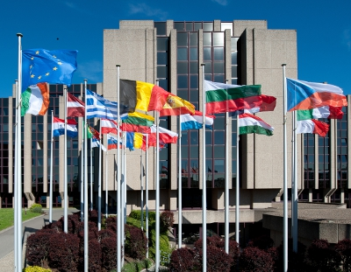
THE COURT OF AUDITORS
Established by the 1975 Budget Treaty and became a formal institution courtesy of the Maastricht Treaty.
It has no judicial function, its primary task is to audit the Union. (Article 285 TFEU)
It consists of one national from each State that act independently for the purpose of the court as a collegial body.
Article 287 TFEU establishes the functions of the Court.
The result of the Audit is published after every financial year and are designed to assist the Parliament and council in their decisions regarding the budget and the Commission in relation to its implementation.

Slide 22
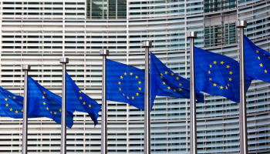
CONCLUSION
The Union is not based on a tripartite structure but is formed through seven key institutions.
Each institution is characterised with its own distinct structure and decision making process ensuring an adequate degree of separation of powers.
The institutional power sharing is the basis of the Union’s system of checks and balances.
There are five key governmental functions;
      Legislative
      Executive
      Judicial
      External
      Financial
Each function has various degrees of procedural scope
in relation to exercising these powers.

