Slide 1
The EUROPEAN UNION
The External Competences of the EU

Slide 2
Internal competences vs external competences
In this section, we focus specifically on external competences
  What are they?
      Common Foreign and Security Policy (CFSP)
      The Union’s special external powers
      European Road Transport Agreement (ERTA)
      The CFSP and special competences
  Nature of external competences
  Procedures in the EU’s external competences
      CFSP decision-making
      Ordinary treaty-making procedure
  Conclusion
CONTENTS

Slide 3
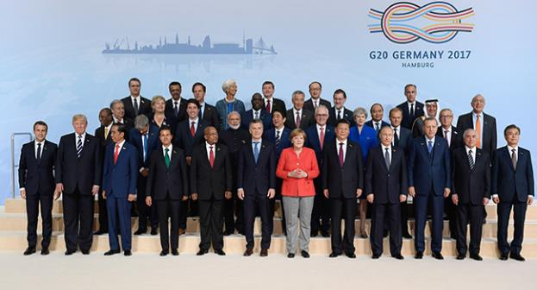
Internal vs external competences
John Locke categorised all external competences under the heading; federative power.
External competences include the power of war and peace, leagues and alliances and all the transactions with all persons and communities with the Union. (Locke, 1988)
Internal competences, on the other hand, relate to the internal functioning of the Union.
Foreign affairs extends to international trade and regulatory agreements.
The TEU acknowledges the internal personality that Union law holds (see Art 47 TEU)

Slide 4

EXTERNAL COMPETENCES
ARTICLE 21 TEU OBJECTIVES
a) safeguard its values, fundamental interests, security, independence and integrity;
(b) consolidate and support democracy, the rule of law, human rights and the principles of international law;
(c) preserve peace, prevent conflicts and strengthen international security, in accordance with the purposes and principles of the United Nations Charter, including those relating to external borders;
(d) foster the sustainable economic, social and environmental development of developing countries, with the primary aim of eradicating poverty;
(e) encourage the integration of all countries into the world economy,
(f) help develop international measures to preserve and improve the quality of the environment and the sustainable management of global natural resources
(g) assist populations, countries and regions confronting natural or man-made disasters; and
(h) promote an international system based on stronger multilateral cooperation and good global governance.
The principle of conferral is still applicable to Article 21 (Art 5(2) TEU)
All of the Unions external actions are guided by the objectives in Article 21.
The competences of the Union in relation to foreign affairs can be found in Title V of the TEU.
Part V of the TFEU enumerates various external policies within which the Union is entitled to act.

Slide 5

THE COMMON FOREIGN AND SECURITY POLICY
Article 24 of Chapter 2, Title V of the TEU grants the Union a general competence regarding the Common Foreign and Security Policy (CFSP):
“The Union’s general competence in matters of common foreign and security policy shall cover all areas of foreign policy and al questions relating to the Union’s security, including the progressive framing of a common defence policy that might lead to a common defence.”
The Common Security and Defence Policy (CSDP) is an integral part of the CFSP.
The CSDP is an operational policy to be applied for the strengthening of international security.
Article 42 of the TEU provides a constitutional guarantee to not infringe upon any member states neutrality.

Slide 6
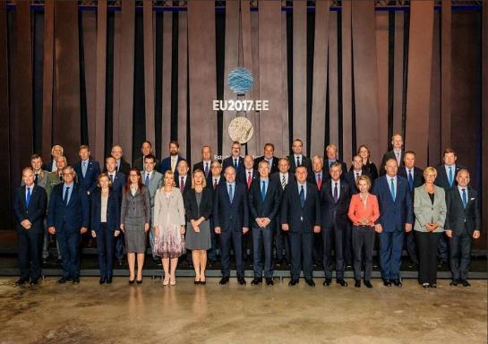
THE UNION’S SPECIAL EXTERNAL POWERS
Art 205 TFEU confirms the common principles and objectives of the Union’s external action.
Part V of the TFEU contains 7 titles:
  3 of the Titles deal with the special external policies of the EU
  2 of the Titles contain institutional matters
  1 of the Title establishes a “Solidarity Clause.”
Title II; Common Commercial Policy
External expression of the internal market. Key task is to continue the harmonious development of world trade. Covers all matters of trade, intellectual property and foreign direct investment.
Title III; Humanitarian aid, Development Cooperation & Assisting Third World Countries
The union can provide ad hoc assistance to those countries in order to meet humanitarian needs.
Title IV; Economic Sanctions
Article 215 TFEU: the Union is not entitled to act upon this competence alone. CFSP competence must be enacted first.

Slide 7


EUROPEAN ROAD TRANSPORT AGREEMENT (ERTA)
The Rome Treaty originally only granted the EU two express treaty-making powers, i.e. CCP & Association Agreements.
The concept of implied external powers was accepted in the ERTA.
A wide teleological interpretation was applied to Art 91 TFEU by the Commission in relation to the need for an additional policy instrument to implement its objectives under the Unions transport competence.
However, the Council opposed this interpretation. The CJEU agreed with the Commission relating to the Union’s powers to adopt any other appropriate provision, which they interpreted as creating the legal power to enter into international treaties.
Article 216 TFEU has attempted to codify the concept of implied external powers.

Slide 8

CFSP & SPECIAL COMPETENCES
CFSP is principally governed by an intergovernmental regime whilst the Union’s special external powers are supranational in power.
Despite this, there is controversy regarding the borderline between the two regimes, which is governed by Article 40 TFEU.
  This Article protects the Union’s supranational procedures and powers by preventing the European Council from using the Union’s CFSP competences.
ECOWAS [2008] established a centre of gravity test.
CFSP is a subsidiary competence similar to Article 352 TFEU as a result of its characterisation as a lex generalis competence.
The Sui Generis Nature of the CFSP Competence
Nature of CFSP competence is part of the European legal order as can be determined from Article 24(1) TEU.
However unlike ordinary Union Law, the direct effect of CFSP is exceptional.
Why is it exceptional?
  Article 24 TEU suggests that neither ordinary or special legislative procedures apply.
  Declaration 14 of the European Treaties suggests that CFSP is a special competence.

Slide 9
Nature of external competences
Article 3(2) TFEU:
- exclusive treaty powers
- there are 3 lines of exclusivity
Exclusive treaty making power when the conclusion of an international agreement “is provided for in a legislative act.”
Opinion 1/94 WTO Doctrine [1994] > codified via Article 3(2)
1
Subsequent exclusivity developed by the Union should be done via (ordinary) Treaty Amendments.
The nature of a competence is not constitutionally fixed as can be seen in Opinion 2/91 (ILO) [1993].
Scope of Union competences is a constitutional question; theoretically it should only be extendable via constitutional amendment.
Constitutional and legislative exclusivity should be examined separately.
Article 3(2) TFEU would have been better expressed in accordance with legislative pre-emption rather than exclusivity of competences.
Exclusive treaty making power where this “is necessary to enable the Union to exercise its internal competence.”
Opinion 1/76 Doctrine [1977] > codified via Article 3(2)
More open definition than the ruling however.
2
ERTA doctrine [1971]; Member States are deprived of their treaty making power when the exercise of those powers affects internal European Law.
If a Common Rule is laid down by the Union, Member States cannot take actions with third countries that affect these rules.
3

Slide 10


EXTERNAL DECISION-MAKING PROCEDURES
The Union’s external actions and the procedures used depends on the type of Act adopted: Unilateral External Acts vs. International Agreements (both instruments are used.)
Constitutional regime for unilateral acts differs from that between CFSP and specialised TFEU external policies- same procedure.
    CFSP procedure
    Ordinary Treaty Making Procedure
It is key to remember that the European Council, per Article 22 TEU, is the Union’s formal and informal guide and peacemaker for all of its external actions.

Slide 11


Specificity of cfsp Decision making
The decision-making procedure for unilateral CFSP acts are specific to the CFSP. (Article 24(1) TEU)
Complex international arrangements exist regarding CFSP;
The central policy maker is the European Council which acts on recommendations from the Council (Article 22(1) & 26(1) TEU)
External representations are made by the President of the European Council. (Article 15(6) TEU)
Other Union institutions may be involved in CFSP as well which complicates matters.
Voting rules for the Council as the central decision-maker can be found in Article 31TEU (Qualified Majority Voting)
Any Member State may, for vital and stated reasons of national policy, declare that it opposes a decision to be taken by QMV via the Luxembourg compromise.

Slide 12
OVERVIEW OF ORDINARY TREATY MAKING PROCEDURE
Article 218 TFEU
Central institution is the Council who acts by QMV and unanimous voting in only 4 particular circumstances under Article 218(8) TFEU.
Generally initiated and conducted by the Commission under Article 218(3) TFEU.
On recommendation, the Council decides whether to negotiate on the matter and can choose its negotiator.
Parliament has little involvement in negotiations. (Article 218(10) TFEU)
Union institutions and Member States can judicially challenge the constitutionality of an agreement before it is concluded. (Article 218(11) TFEU)
The Council concludes any agreement with active involvement from the Parliament (unless it exclusively relates to CFSP) (Article 218(6) TFEU)
Parliament needs to formally consent to the negotiated treaty. (Article 218(6)(a) TFEU)
Doctrine of functional succession is applied when the Union succeeds to international agreements of Member States. (International Fruits [1972])

Slide 13


SHARING EXTERNAL POWER
States are sovereign subjects of international law. This means the enjoy full external powers. However, this is not the case in relation to the Union, as external powers are shared. (we call this duality)
Mixed agreements are used by the Union in order to involve Member States and the Union in any international agreements that involve them both. This mechanism is widely used and successful.
Member States also have the duty to co-operate with the Union as well. (Article 4(3) TFEU) In external affairs this duty to co-operate means Member States must co-ordinate their international powers under a mixed agreement Member States can also be viewed as being the trustees of the Union as well. (Opinion 2/91 (ILO) [1993])
Reversed subsidiarity exists to limit Member States power in order to ensure the effectiveness of the Union in making agreements. (Commission vs. Luxembourg [2005])

Slide 14
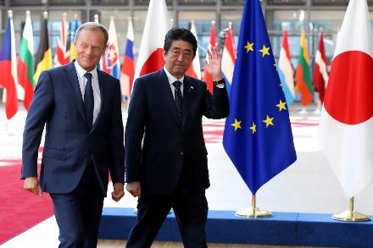

CONCLUSION
The European Union has international personality.
The External competences are conferred competences.
CFSP is seen as sui generis competence.
Exclusive treaty making competence is also separate from the Unions general legislative competence.
The external competences of the Union can be difficult due to the sovereignty of Member States and their individual involvement in the international arena.
Member States are involved through Mixed Agreements but they are prevented from exercising their shared competence in order to prevent, “splitting the international representation of the Union.” (Commission vs. Sweden [2010])

